Slide 1
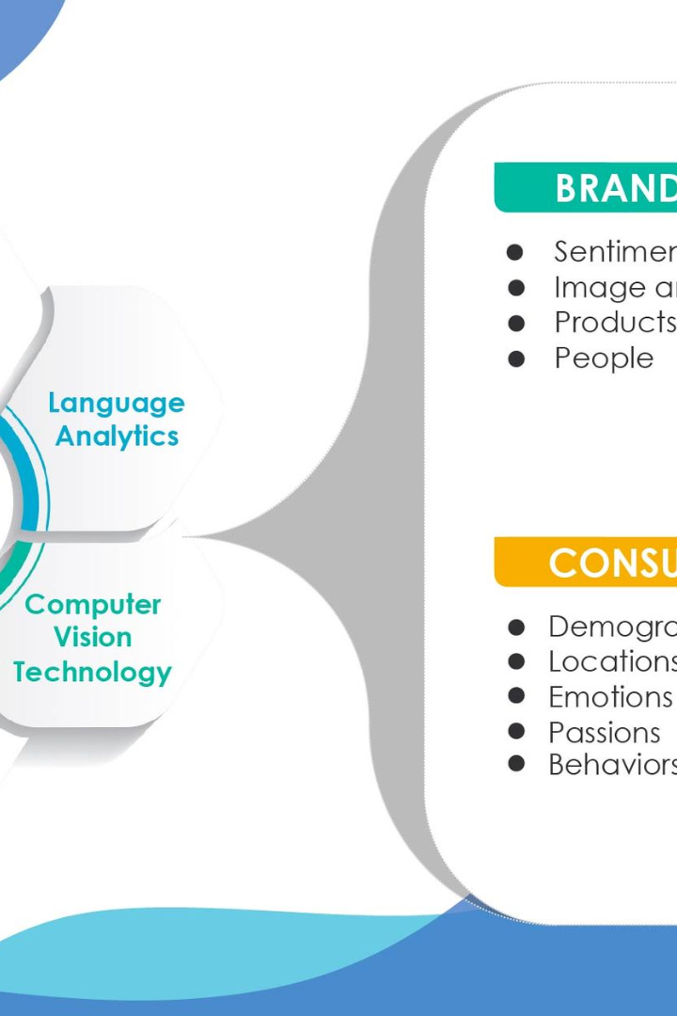
Text Processing For NLP String Tokenization
Unlock the power of NLP with advanced text processing techniques. Learn about string tokenization and its importance in NLP.

Slide 2


What is String Tokenization?
Breaking Down Text Into Units
Breaking Down Sentences
Code Implementation
Sentences can also be tokenized, which is useful for language-specific tasks like part of speech tagging.
Implementing tokenization in code involves using libraries like NLTK or spaCy to split the text into tokens.
With tokenization, a text document is broken down into individual units, which could be words, phrases, or even paragraphs.

Slide 3
Why is String Tokenization Important in NLP?
Data Preprocessing
Speed and Efficiency
Tokenization is a crucial component of data preprocessing in NLP, as it helps facilitate downstream tasks such as sentiment analysis and machine translation.
Tokenization can speed up NLP processes and reduce computational resource consumption by breaking down long and complex text into smaller segments.
Language-Specific Tasks
Improved Accuracy
Tokenization is important for language-specific tasks such as speech recognition, where breaking down spoken words into individual units is crucial for transcription accuracy.
Tokenization can improve the accuracy of NLP models by reducing complexity and noise in raw text, allowing for more reliable analysis.

Slide 4
Types of Tokenization Techniques
Rule-Based
Statistical
Hybrid
These techniques rely on pre-defined rules or patterns to split up text into tokens. Examples include whitespace tokenization and punctuation tokenization.
These techniques use statistical models and algorithms to split up text into tokens. Examples include machine learning and deep learning models.
Hybrid tokenization techniques combine the best of both worlds, utilizing both rule-based and statistical approaches to create a more accurate and efficient tokenization process.

Slide 5
Benefits of String Tokenization
Efficient Text Processing
Tokenization can speed up text processing and reduce the resources required by downstream NLP tasks by breaking down text into smaller segments.
1
2
3
Improved Data Quality
Greater Accuracy
Tokenization can improve data quality and make it more amenable to analysis by breaking down text into smaller and more manageable segments.
Tokenization can enhance the accuracy of NLP models by reducing complexity and noise during text processing, allowing for more reliable analysis.

Slide 6

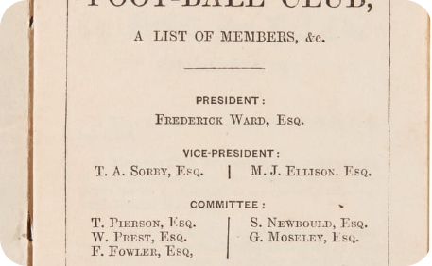

Rule-Based Tokenization
Defining Punctuation Rules
Customizing for Specific Domains
Disadvantages
Rule-based tokenization involves defining rules or patterns that determine how text is split into tokens. Example: breaking down text by whitespace or punctuation marks.
Rule-based tokenization can be inflexible and unable to handle complex or irregular text, such as text with nested clauses or parentheses.
Rule-based tokenization can be customized for specific domains and languages, allowing for more targeted and accurate text processing.

Slide 7

Statistical Tokenization
1
Advanced Machine Learning Techniques
2
Training Data Is Required
3
Inherent Complexity
Statistical tokenization can be inherently complex, making it difficult to fine-tune and customize for specific domains and languages.
Statistical tokenization involves using advanced machine learning techniques to split text into tokens, allowing for greater flexibility and accuracy.
Statistical tokenization requires large amounts of annotated training data to accurately train machine learning models.

Slide 8
Hybrid Tokenization
Advantages
Disadvantages
Combines the strengths of both rule-based and statistical approaches, allowing for greater accuracy and flexibility.
Can be difficult to implement and requires advanced knowledge of NLP techniques and algorithms.
Allows for customization and fine-tuning for specific domains and languages.
Requires large amounts of data to train machine learning models, making it resource-intensive.

Slide 9
Challenges in Tokenization
Ambiguity
Different Sentence Structures
Language-Specific Considerations
Text can be inherently ambiguous, making it difficult to determine how it should be split into tokens, especially in languages like English with complex word structures.
Sentence structure can vary widely within a given language, making sentence tokenization a particularly challenging task.
Tokenization in languages other than English can be challenging due to differences in grammar, punctuation, and sentence structure.

Slide 10

Conclusion and Future Directions
1
The Importance of String Tokenization
2
Future Research Directions
String tokenization plays a crucial role in NLP processes by allowing for accurate and efficient text processing and analysis.
Future research in NLP should focus on further refining and optimizing string tokenization techniques to improve text processing and analysis capabilities.
3
Conclusion
String tokenization is a powerful technique that has already revolutionized the field of NLP, and it is poised to continue driving innovation and research in the future.

